Slide 1
Data Structures & Algorithms (CSC-214)
Lec 6: Arrays ADT and C++ Implementation

Slide 2
Arrays ADT
An array is defined as
Ordered collection of a fixed number of elements
All elements are of the same data type
Basic operations
Direct access to each element in the array
Values can be retrieved or stored in each element

Slide 3
Properties of an Array
Ordered
Every element has a well-defined position
First element, second element, etc
Fixed size or capacity
Total number of elements are fixed
Homogeneous
Elements must be of the same data type (and size)
Use arrays only for homogeneous data sets
Direct access
Elements are accessed directly by their position
Time to access each element is same
Different to sequential access where an element is only accessed after the preceding elements

Slide 4
Recap: Declaring Arrays in C/C++
datatype arrayName[intExp];
datatype – Any data type, e.g., integer, character, etc.
arrayName – Name of array using any valid identifier
intExp – Constant expression that evaluates to a positive integer. Why constant?
Example:
const int SIZE = 10;
int list[SIZE];
Compiler reserves a block of consecutive memory locations enough to hold SIZE values of type int
Notes:
Varaible length arrays are not standard C++, code will not be portable, not compilable with Microsoft
-Needs GCC or Clang

Slide 5
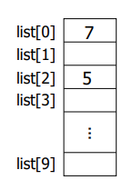
Recap: Accessing Arrays in C/C++
arrayName[indexExp];
indexExp – called index, is any expression that evaluates to a positive integer
In C++
Array index starts at 0
Elements of array are indexed 0, 1, 2, …, SIZE-1
[ ] is called array subscript operator
Example
int value = list[2];
list[0] = value + 2;

Slide 6


Recap: Array Initialization in C++ (1)
dataType arrayName[intExp]= {list of values};
Arrays can be initialized at declaration
intExp is optional: Not necessary to specify the size if values are given
Example: Numeric arrays
double score[ ] = {0.11, 0.13, 0.16, 0.18, 0.21}
Example: Character arrays
char vowel [5] = { ‘A’, ‘E’, ‘I’, ‘O’, ‘U’ }

Slide 7
Recap: Array Initialization in C++ (2)
Fewer values are specified than the declared size of an array
Numeric arrays: Remaining elements are assigned zero
Character arrays: Remaining elements contain null character ‘\0’ (ASCII code of ‘\0’ is zero)
If more values are specified than declared size of an array – Error is occurred: Handling depends on compiler

Slide 8
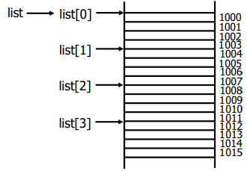
Array Address Translation (1)
int list [4] = { 1, 2, 4, 5};
Compiler allocates a block of four memory spaces
Each memory space is large enough to store an int value
Four memory spaces are contiguous
Base address
Address of the first byte in the contiguous block of memory
Address of the memory location of the first array element
Address of element list[0]
Memory address associated with arrayName stores the base address
cout << list << endl;
cout << *list << endl;

Slide 9
Array Address Translation (2)
Consider a statement: cout << list[3];
Requires array reference list[3] be translated into memory address
Offset: Determines the address of a particular element w.r.t. base address
Translation:
Base address + offset = 1000 + 3 x sizeof(int) = 1012
Content of address 1012 are retrieved & displayed
An address translation is carried out each time an array element is accessed
What will be printed and why?
cout << *(list+3) << endl;

Slide 10
Questions
Why does an array index start at zero?
Why arrays are not passed by value?

Slide 11
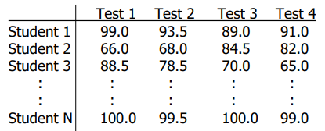
Multidimensional Arrays
Most languages support arrays with more than one dimension
High dimensions capture characteristics/correlations associated with data
Example: A table of test scores for different students on several tests
2D array is suitable for storage and processing of data

Slide 12
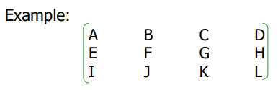
Multidimensional Arrays
More complicated than one dimensional arrays
Memory is organized as a sequence of memory locations
One-dimensional (1D) organization
How to use a 1D organization to store multidimensional data?
A character requires single byte
Compiler request to reserve 12 consecutive bytes
Two way to store consecutively, i.e., row-wise and column-wise

Slide 13
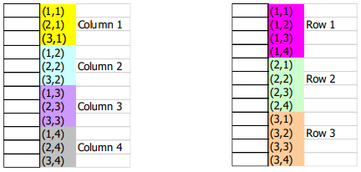
Two-Dimensional Arrays in Memory
Two ways to be represented in memory
Column majored: Column by column
Row majored: Row by row
Representation depends upon the programming language

Slide 14
Two-Dimensional Arrays – Declaration
dataType arrayName[intExp1][intExp2];
intExp1 – constant expression specifying number of rows
intExp2 – constant expression specifying number of columns
Example:
const int NUM_ROW = 2, NUM_COLUMN = 4;
double score[NUM_ROW][NUM_COLUMN];
Initialization:
double score[ ][4] = { {0.5, 0.6, 0.3}, {0.6, 0.3, 0.8}};
List the initial values in braces, row by row
May use internal braces for each row to improve readability

Slide 15
Two Dimensional Arrays – Initialization
double score[ ][4] = { {0.5, 0.6, 0.3}, {0.6, 0.3, 0.8}};
double score[ ][4] = { 0.5, 0.6, 0.3, 0.6, 0.3, 0.8};
Output will be different in the above cases.

Slide 16
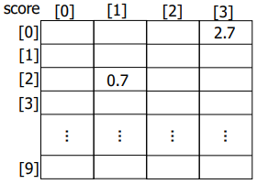
Two Dimensional Arrays – Processing
arrayName[indexExp1][indexExp2];
indexExp1 – row index
indexExp2 – column index
Rows and columns are numbered from 0
Use nested loops to vary two indices – Row-wise or column-wise manner
Example
double value = score[2][1];
score[0][3] = value + 2.0;

Slide 17
Higher Dimensional Arrays
const int SEMS = 10, STUDENTS = 30, TESTS = 4;
int ThreeDimArray[SEMS][STUDENTS][TESTS];
All indices start from zero
What is represented by ThreeDimArray[4][2][3]?

Slide 18
Higher Dimensional Arrays
const int SEMS = 10, STUDENTS = 30, TESTS = 4;
int ThreeDimArray[SEMS][STUDENTS][TESTS];
All indices start from zero
What is represented by ThreeDimArray[4][2][3]?
Score of 3rd student belonging to 5th semester on 4th test
Notes:
using ThreeDimArray = double[SEMS][STUDENTS][TESTS];
ThreeDimArray gradeBook;

Slide 19
Higher Dimensional Arrays
const int SEMS = 10, STUDENTS = 30, TESTS = 4;
int ThreeDimArray[SEMS][STUDENTS][TESTS];
Address translation of a 3-D array?

Slide 20
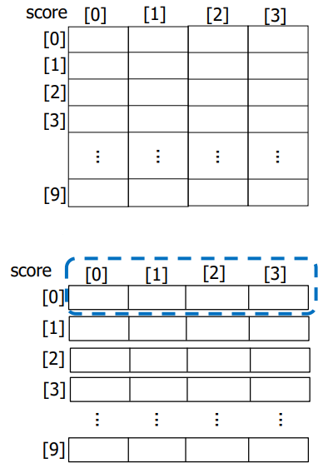
Array of Arrays (1)
Consider the declaration
double score[10][4];
Another way of declaration: 1D array of rows
using RowOfTable = double[4];
RowOfTable score[10];
In detail
Declare score as 1D array containing 10 elements
Each of 10 elements is 1D array of 4 real numbers (i.e., double)

Slide 21
Array of Arrays (2)
score[i]
Indicates i th row of the table
score[i][j]
Can be thought of as (score[i])[j]
Indicates j th element of score[i]
How will we make a 3-D array using a 2-D object?

Slide 22
Array of Arrays (2)
score[i]
Indicates i th row of the table
score[i][j]
Can be thought of as (score[i])[j]
Indicates j th element of score[i]

Slide 23

Array of Arrays – Address Translation
How to access the value of score[5][3]?
Suppose base address of score is 0x12348
Address of 6th element of score array, i.e., score[5]
0x12348 + 5 x sizeof(RowOfTable) = 0x12348 + 5 x (4 x 8) = 0x124A8
Address of score[5][3]
Address of score[5] + 3 x sizeof(double) = 0x124A8 + 3 x 8 = 0x124A8

Slide 24
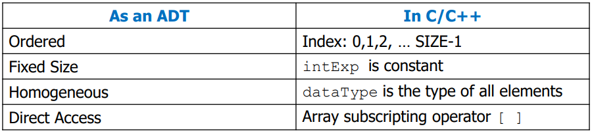
C++ Implementation of an Array ADT

Slide 25
Any Questions?

